Slide 1
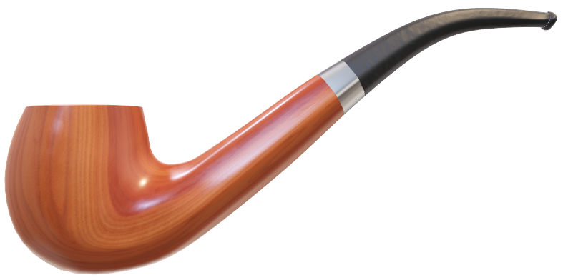
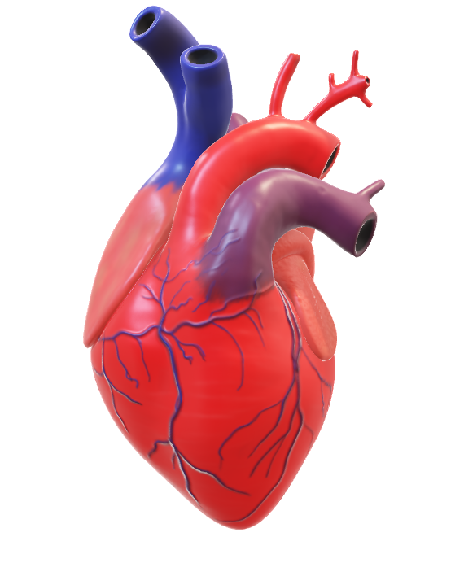
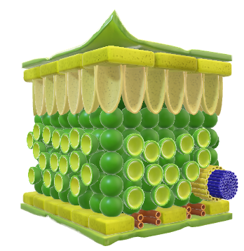
Binary Prediction of Smoker Status using Bio-Signals
Team Explorers
DataSource
Walter Reade, Ashley Chow. (2023). Binary Prediction of Smoker Status using Bio-Signals. Kaggle. https://kaggle.com/competitions/playground-series-s3e24
Link to Project Repository : Github

Slide 2
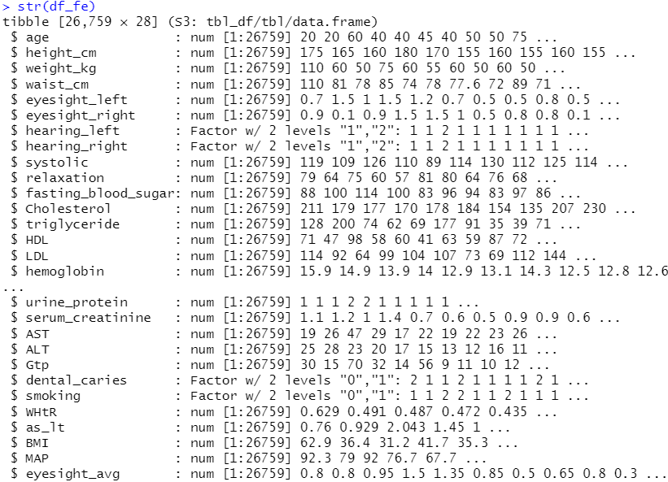
Available Data Variables and Featured Data Variables
Dataset
Samples – 26,759
Features – 22
Output – 1
Smoker
Non Smoker
Original Features (22)
Target
Engineered Features (5)

Slide 3
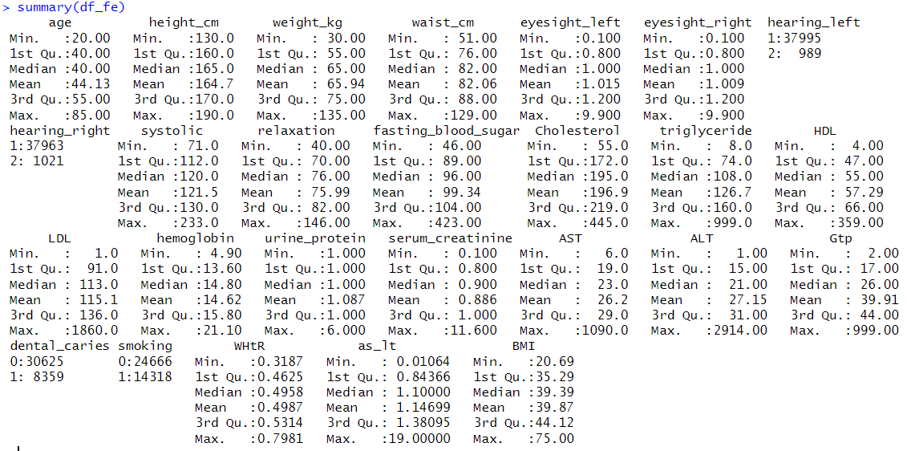

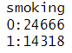
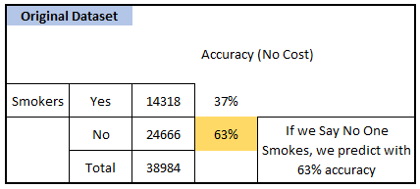
No Cost Prediction
Say all are Non-Smokers
and
You’re correct 63% times.
Can We Do Better than this ?

Slide 4
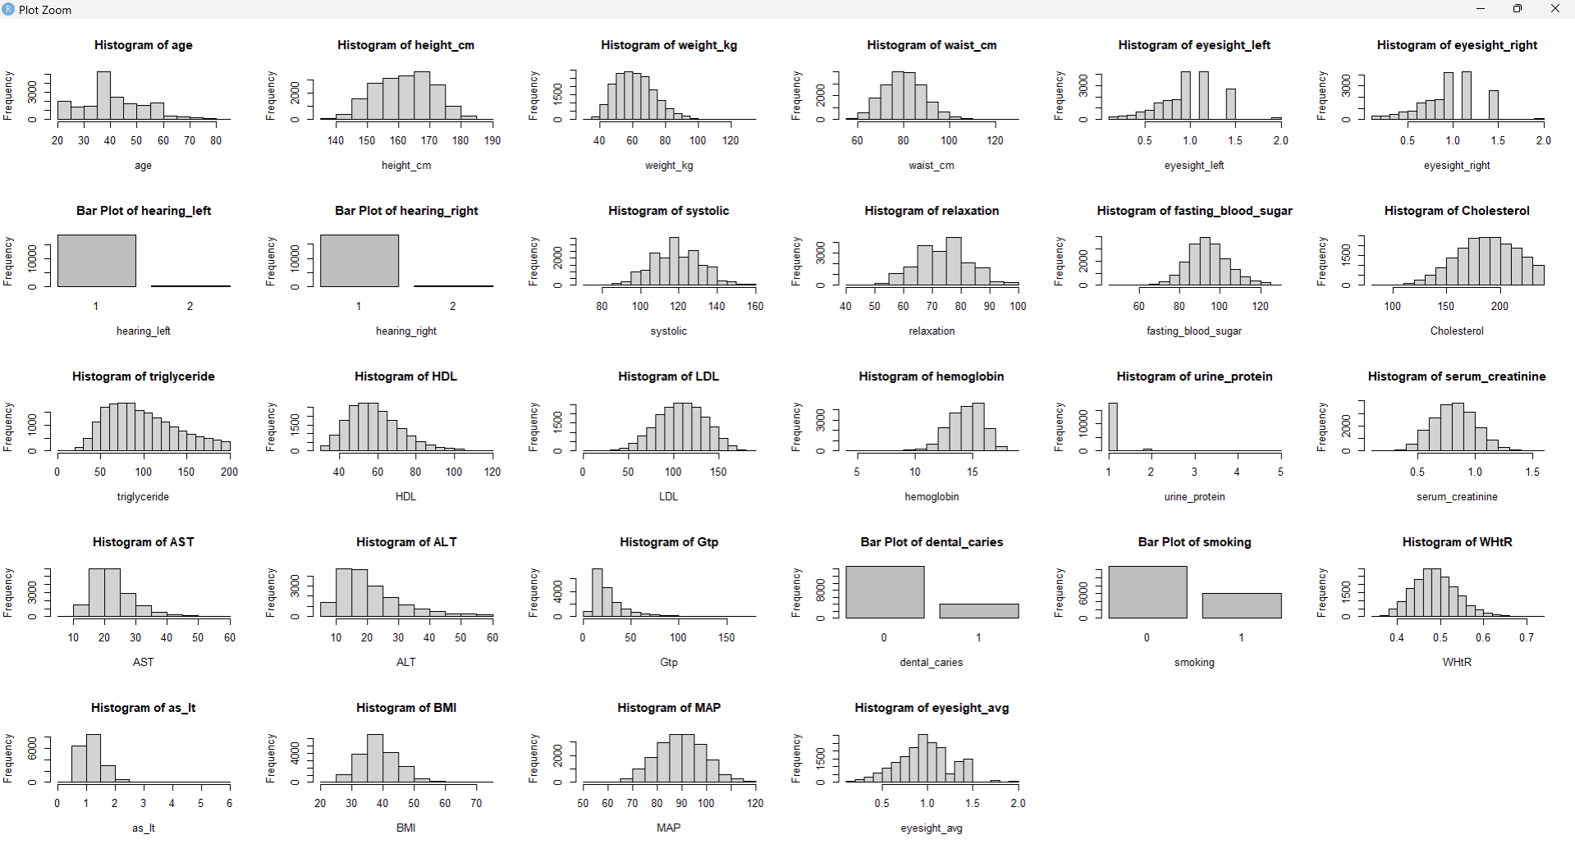
Histograms of Variables after Removal of Outliers

Slide 5
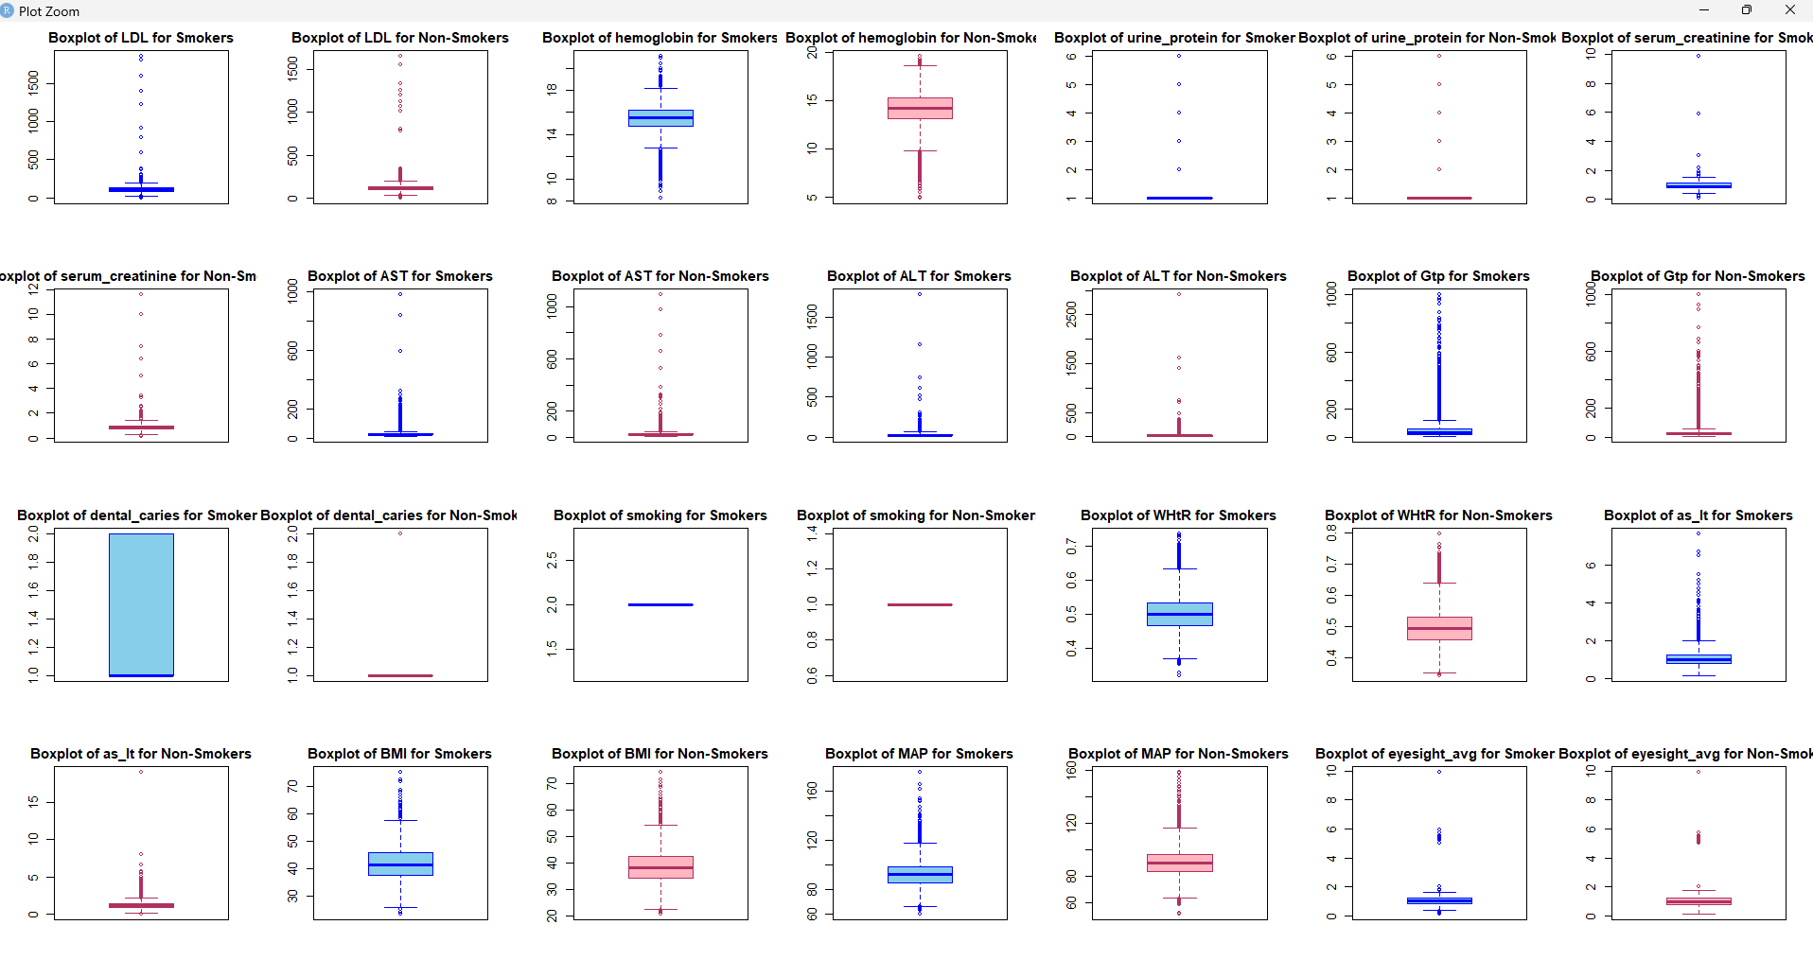
Prior to Removal of Outliers

Slide 6
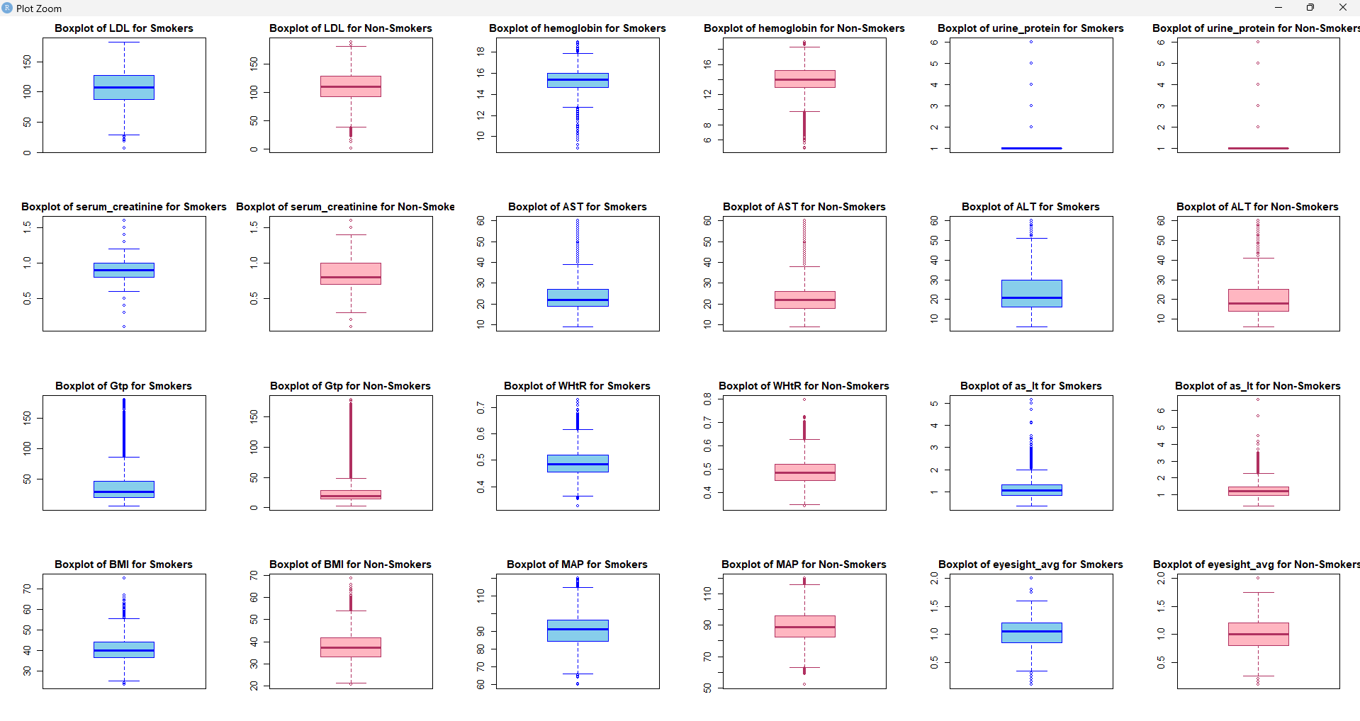
After Removal of Outliers

Slide 7
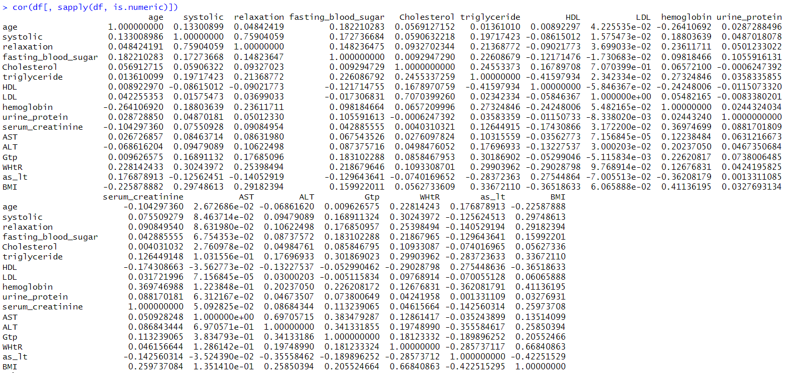



























Data Correlations Before Removing Outliers
Yellow -> Autocorrelations (Diagonal)
Blue -> >=40% Correlations
Pink -> >=30% Correlations

Slide 8
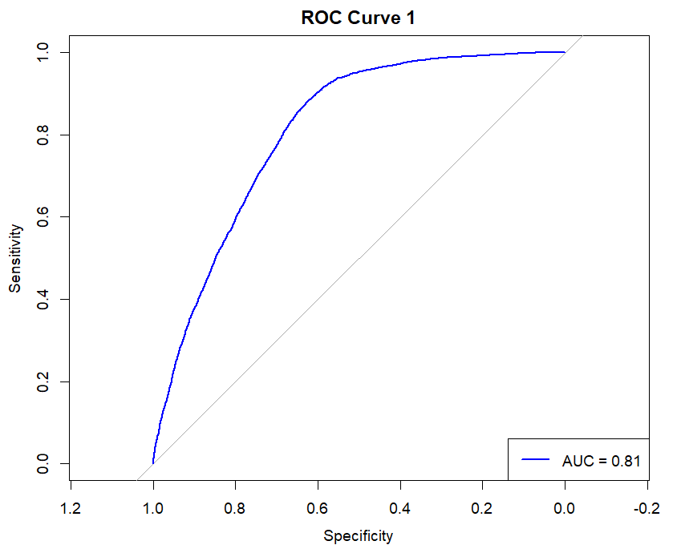
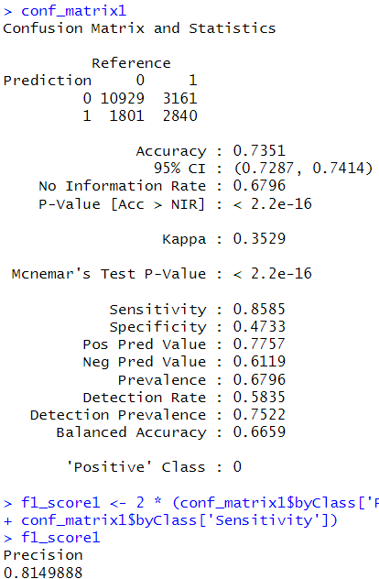

Fit the Model on all parameters
glm.fits1
Boom
Did Just Something and Accuracy ~ 73%
AUC ~ 81.5%

Slide 9

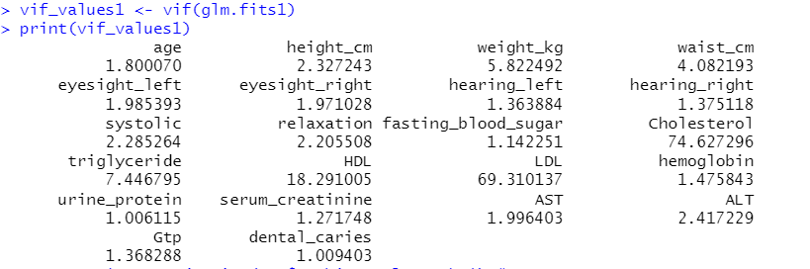
But Who will take Consideration of the Inflated Variation ?

Slide 10
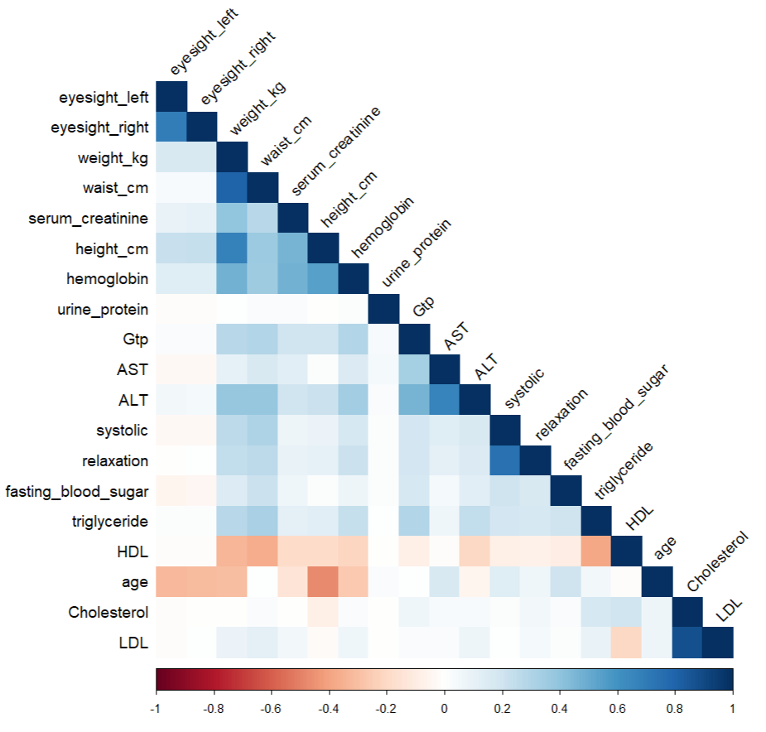
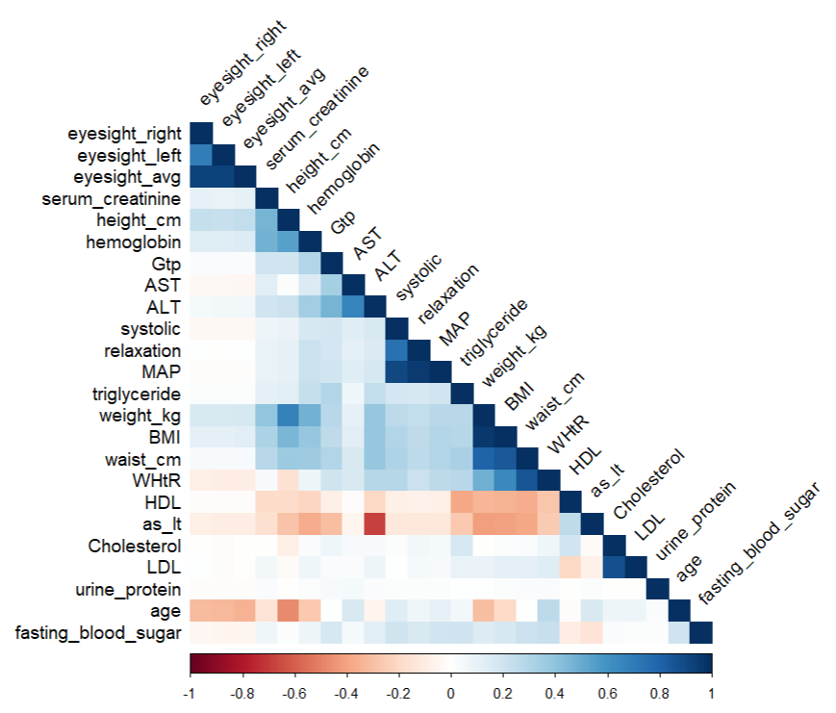
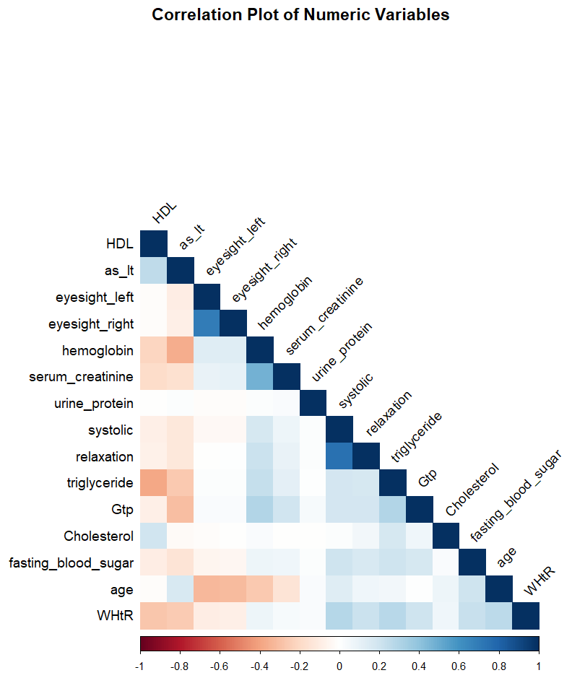
Correlation Matrix (Original Dataset)
Correlation Matrix (Training Dataset with Featured Predictors)
Correlation Matrix of Numeric Variables in Training Data

Slide 11
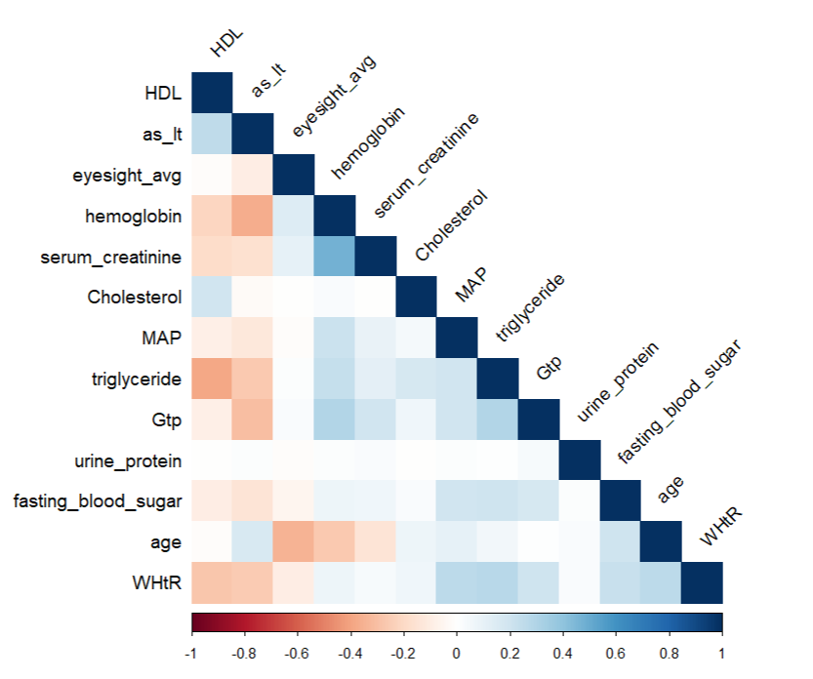
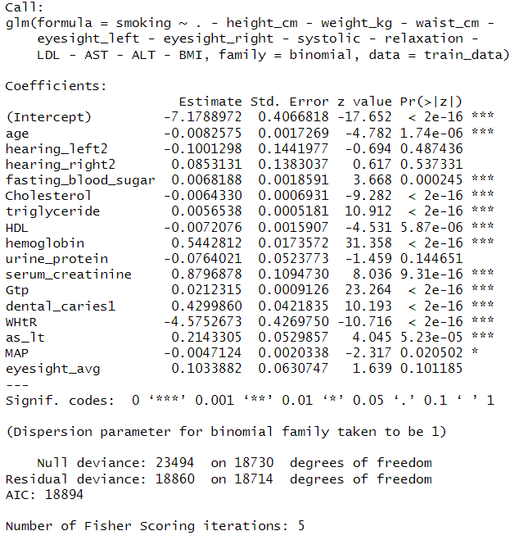
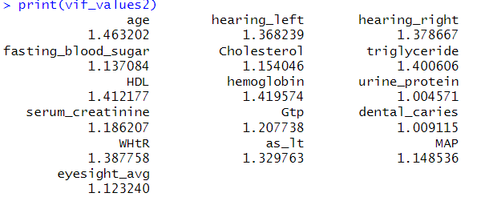
glm.fits2 – Fit Model on Selected Parameters (Removing Correlated Predictors)
Correlation Matrix of Fitted Variables

Slide 12
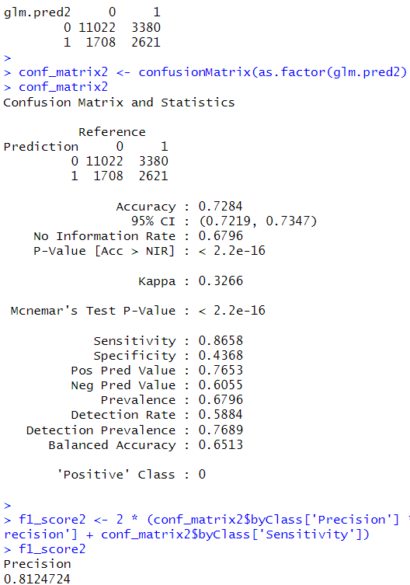
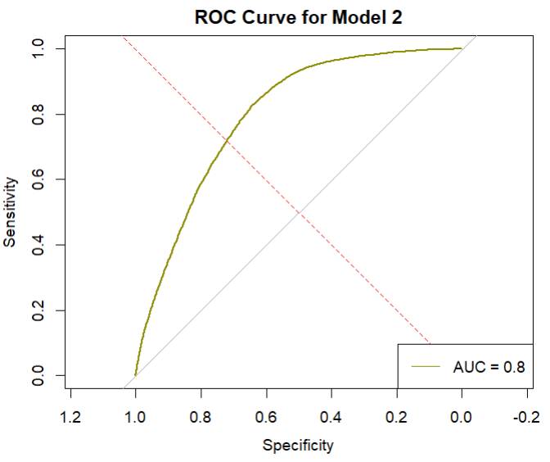
Training Set

Slide 13
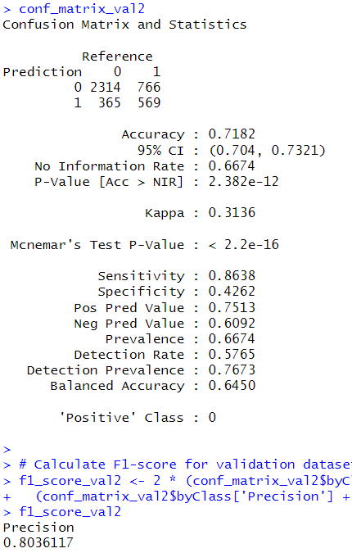
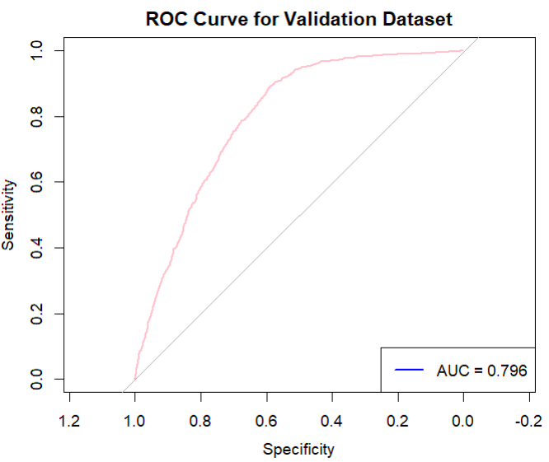
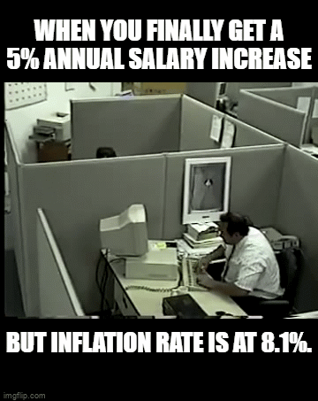
Validation Set
An Accuracy of 72% ?
Just a 7% Increase than the No Cost Prediction (Not worthy of the cost)

Slide 14
Application Of Random Forest
Implemented Methodology :
Split the data into training, validation, and test sets, tuning the model using the validation set, and evaluating the final model using the test set.
1. Model Training and Tuning:
Training the Random Forest models with different numbers of trees using the training data.
Evaluate the models using the validation set and select the best-performing model based on validation accuracy.
2. Model Evaluation:
Evaluated the best model using the test set and calculated the test accuracy. (Also it performed better than the Logistic Regression on the Training and Validation data)
Calculated confusion matrices and F1 scores for the training, validation, and test sets.
Plotted the ROC curves for the training, validation, and test sets to visualize the model's performance in terms of sensitivity and specificity.

Slide 15
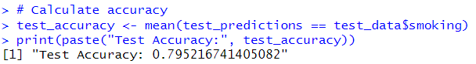
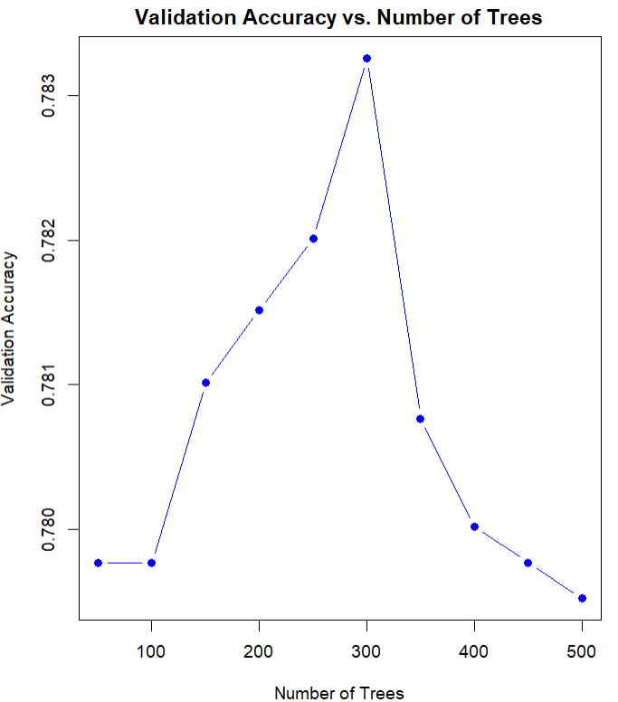
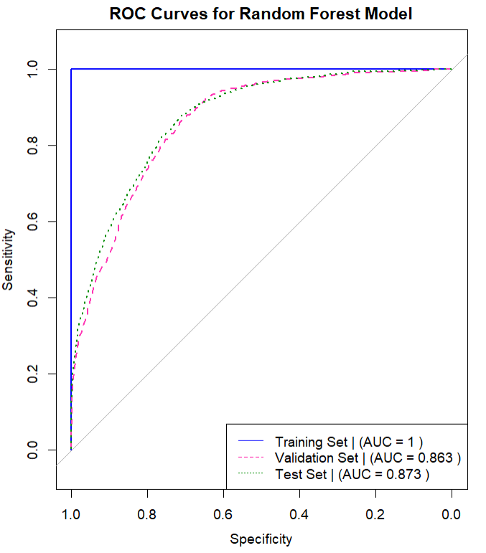

Application Of Random Forest
An Accuracy of 79% ?
~ 10.7% Increase than the “Logistic regression”
~ 19.18% More than No Cost Prediction

Slide 16
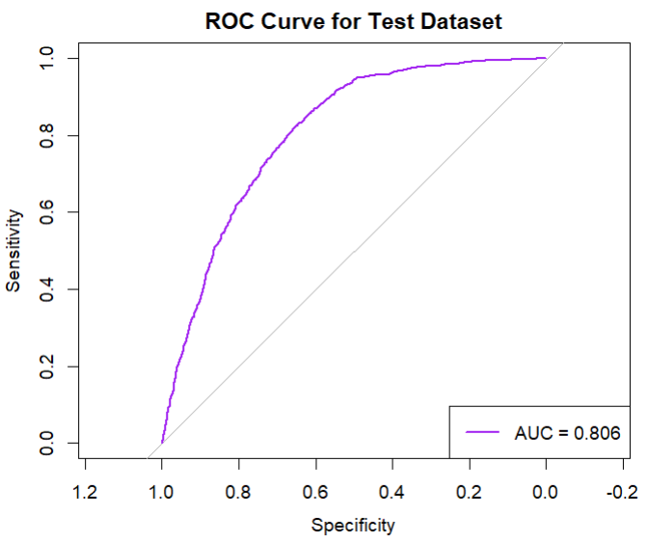
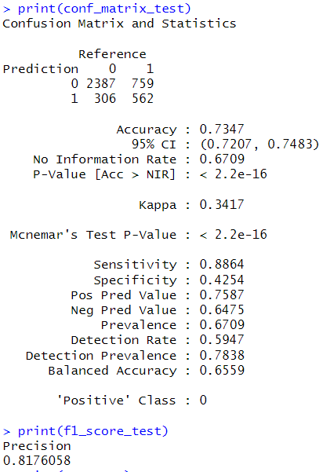
“Curiosity Check” - Logistic Regression on the Test data

Slide 17
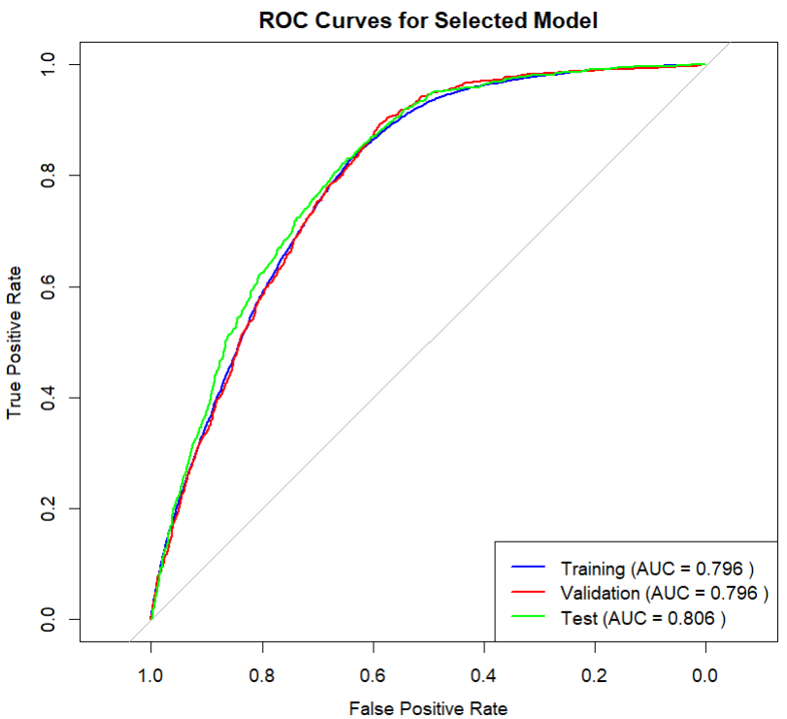
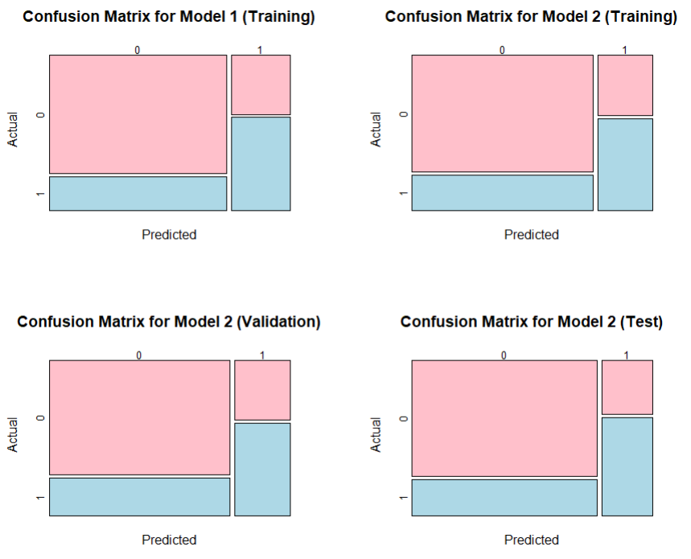
“Curiosity Check”
No Significant Difference in Performance

Slide 18
What else we can do ?
Random Forest ->
We have tuned the number of trees, but we also tune the depth of trees, mtry and other parameters to find maybe a better model (if there is?).
(Not Yet performed though).
So, parked for some other time.

Slide 19
Unsupervised Approach :
Using PCA and K-Means to Cluster the data into Two Parts (K=2) (Smokers and Non-Smokers)

Slide 20
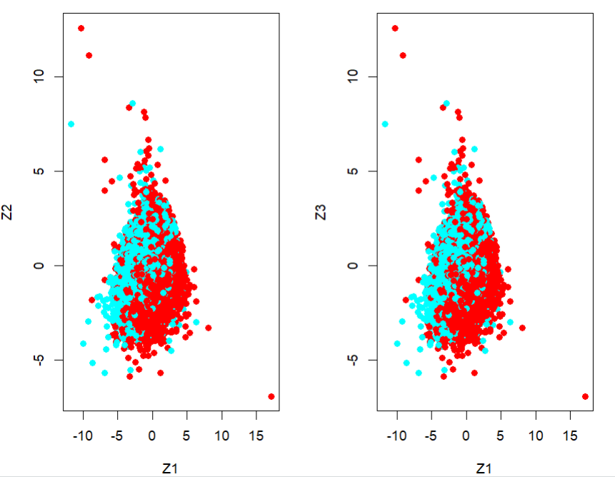
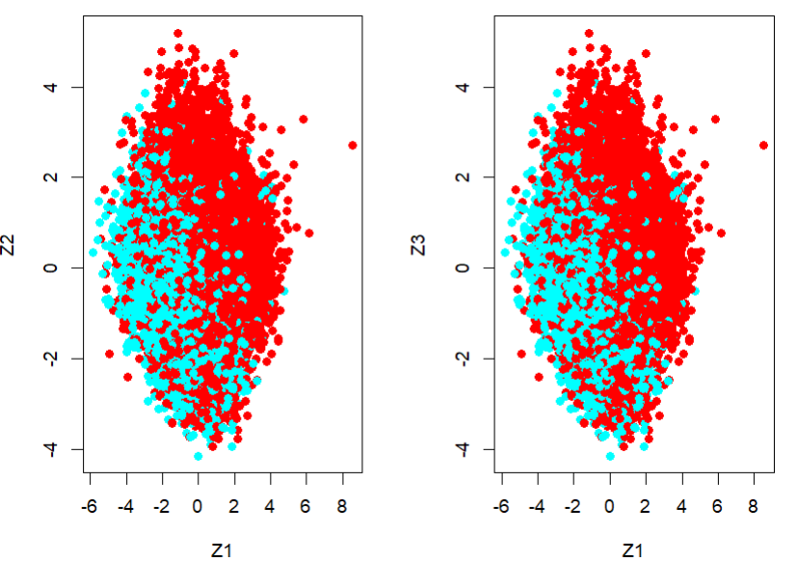
Prior to Removal of Outliers
After Removal of Outliers

Slide 21
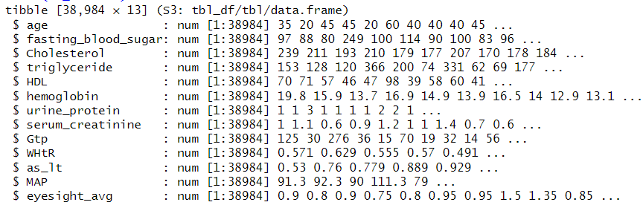
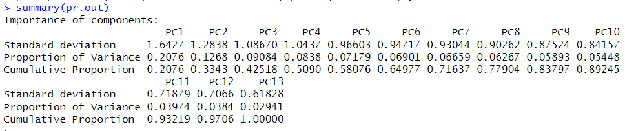
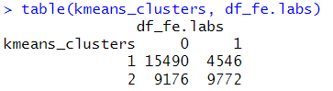

Slide 22
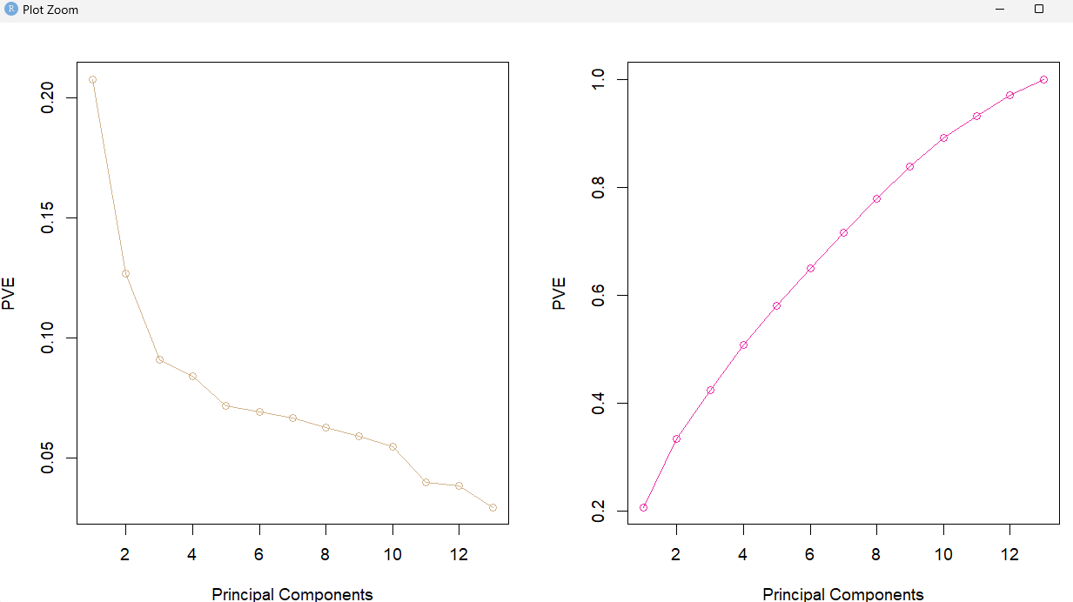
Prior to Removal of Outliers
A silhouette score of 0.1758 suggests that the clusters have some degree of separation, but there may still be some overlap between them.

Slide 23
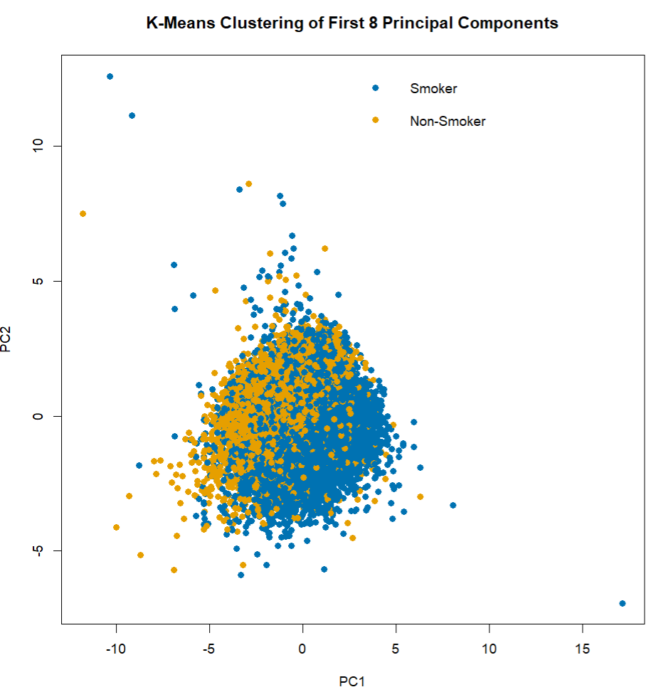
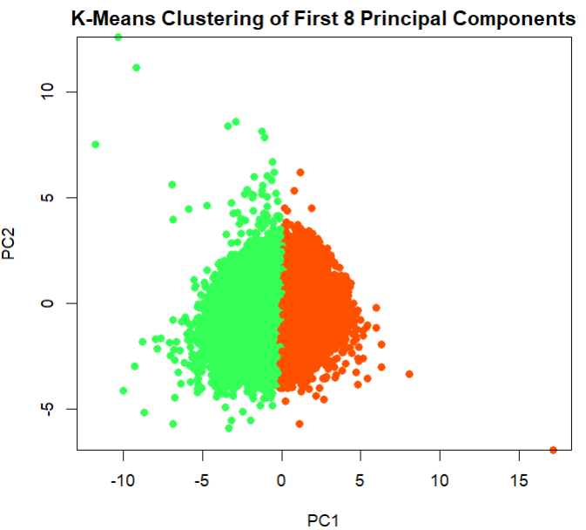
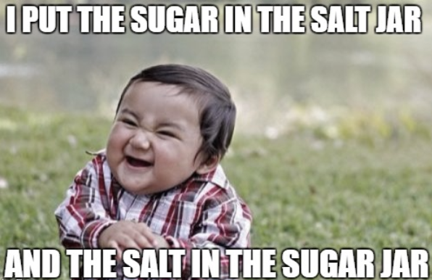
Prior to Removal of Outliers
A silhouette score of 0.1758 suggests that the clusters have some degree of separation, but there may still be some overlap between them.

Slide 24
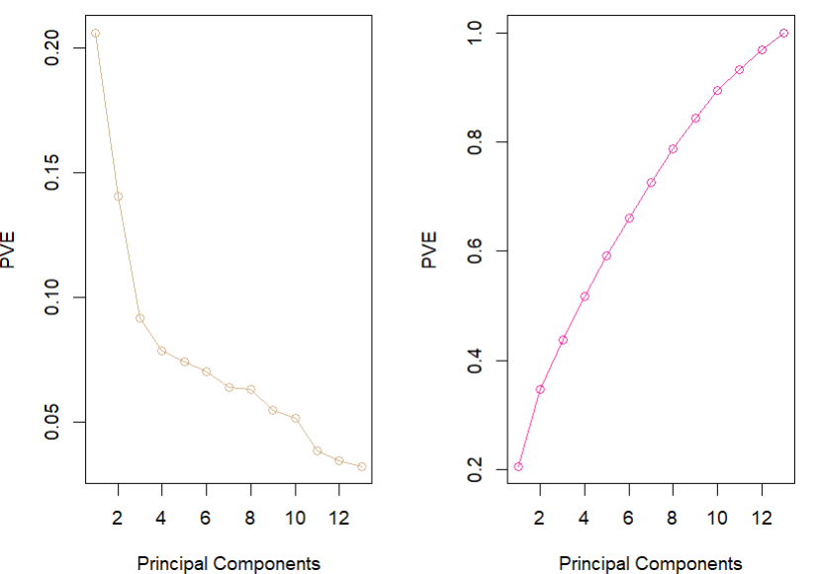
After Removal of Outliers

Slide 25
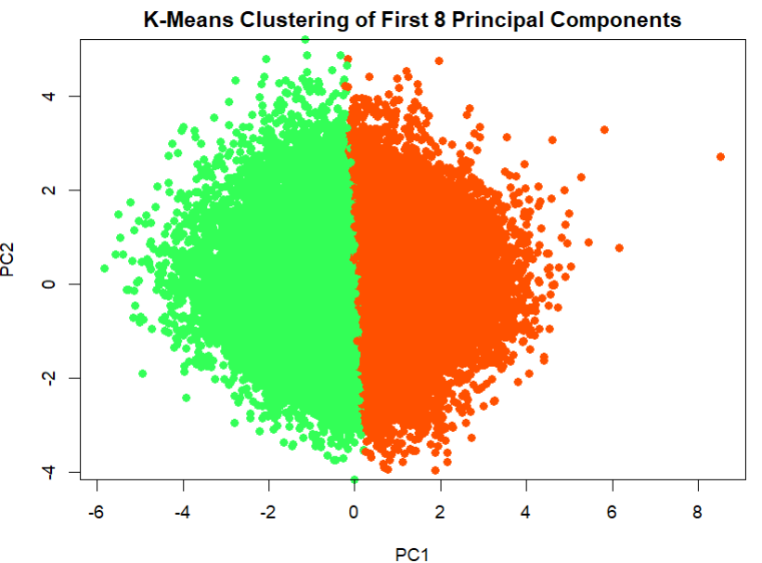
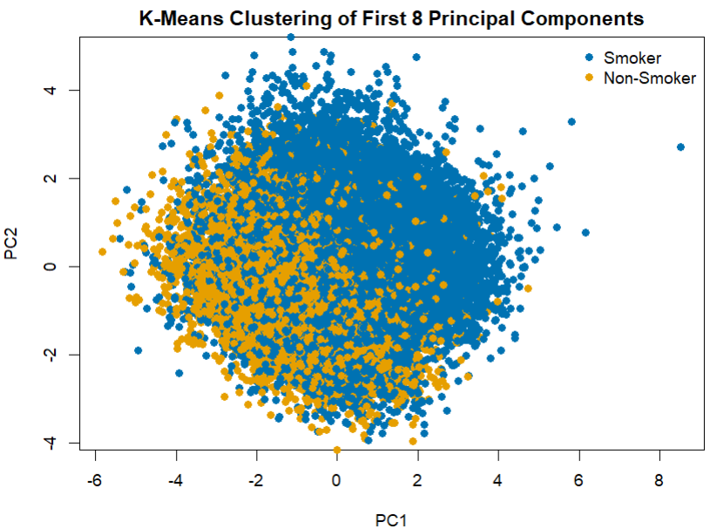
After Removal of Outliers
A silhouette score of 0.1664 suggests that the clusters have some degree of separation, but there may still be some overlap between them.

Slide 26
Conclusion
In conclusion, the comparison between the unsupervised clustering approach and the supervised Random Forest Algorithm revealed that the latter demonstrated superior performance in our analysis. This observation may be attributed to several factors, among which the most prominent is the potential absence of distinct separation points within the data clusters.
For unsupervised learning approaches, we can still apply and check results using density-based clustering algorithms or hierarchical clustering with appropriate distance metrics, may yield better results.
In all, the model can still be investigated for any further improvements, or by collecting additional data points.
*Snapshots of references used for study

Slide 27
Appendix
*Snapshots of references used for study

Slide 28
Constraints Used for Removal of Outliers
Cholesterol greater than 240.
LDL (Low-density lipoprotein) greater than 190.
Eyesight in the left eye greater than 2.
Eyesight in the right eye greater than 2.
Fasting blood sugar greater than 126.
Systolic blood pressure greater than 160.
Diastolic blood pressure (relaxation) greater than 100.
Triglyceride greater than 200.
HDL (High-density lipoprotein) less than 30 or greater than 120.
Hemoglobin greater than 19.
Serum creatinine greater than 1.6.
AST (Aspartate transaminase) less than 9 or greater than 60.
ALT (Alanine transaminase) less than 6 or greater than 60.
GTP (Gamma-glutamyl transferase) greater than 180.
*Snapshots of references used for study

Slide 29
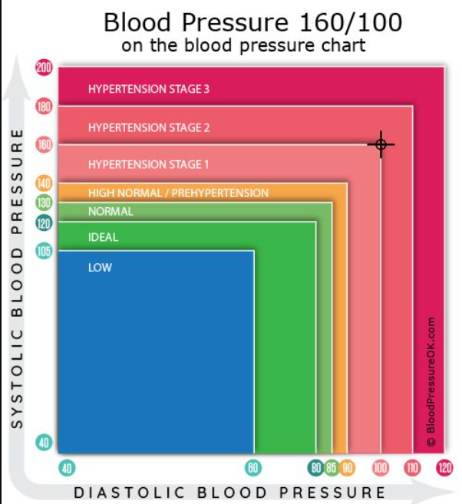
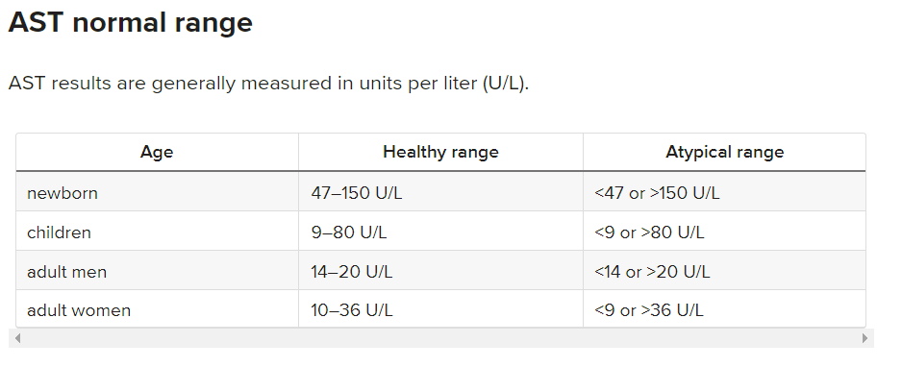
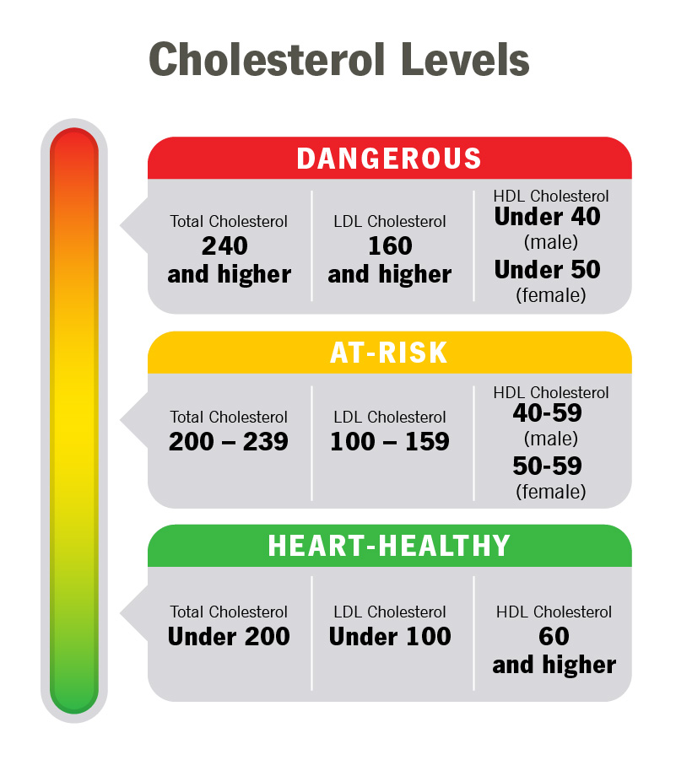
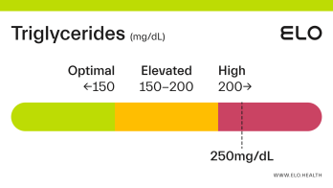

Cholesterol Levels are Averaged Out for Males and Females
Total Cholesterol –
240+ - Dangerous
200-239 -> At Risk
< 200 -> Healthy
LDL
160+ - Dangerous
100 – 159 -> At Risk
< 100 -> Healthy
HDL
< 45 - Dangerous
45 – 60 > At Risk
60+ -> Healthy
Source: https://my.clevelandclinic.org/health/articles/11920-cholesterol-numbers-what-do-they-mean
Triglycerides Levels
200+ - Dangerous
150-200 -> At Risk
< 150 -> Healthy

Slide 30
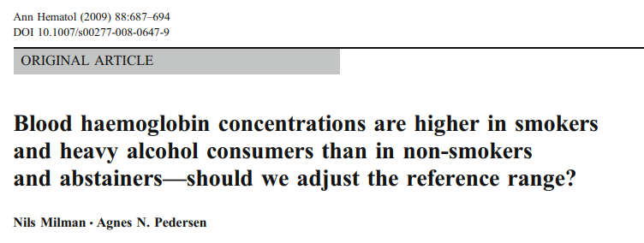
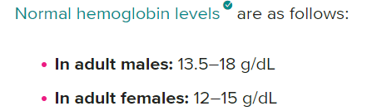


Source: https://hal.science/hal-00535009/document
Source: https://www.mayoclinic.org/tests-procedures/liver-function-tests/about/pac-20394595#:~:text=Standard%20range%20blood%20test%20results,8%20to%2048%20U%2FL%20
Source: https://www.kidney.org/news/kidneyCare/winter09/DontSmoke#:~:text=The%20Surgeon%20General%20issued%20a,your%20kidneys%20are%20under%20stress

Slide 31


Source: https://drlogy.com/calculator/ast-alt-ratio
Source: https://www.ncbi.nlm.nih.gov/pmc/articles/PMC3222662/

Slide 32


Source: https://pubmed.ncbi.nlm.nih.gov/29524646/
Source: https://www.ncbi.nlm.nih.gov/books/NBK538226/

